Slide 1

Predicting Spot Exchange Rates with ARIMA
Submitted by
Puneet Jain
Roll. No.: BL.EN.P2DSC20031
Degree : M.Tech (Data Science)
Semester : 2 Sem
Subject : 19DS617 (TSA) & 18RM600 (RM)

Slide 2
Overview
Abstract
Introduction
Objective
Literature Survey
Analysis
Methodology
Conclusion
Future Scope
References

Slide 3
Abstract
Exchange rate is very important at the national, regional and international levels. It can help investors minimize financial risk as well maximize earnings in the volatility of the global economy. Considering past values of dollar/euro exchange rate, build an ARIMA model and studied the volatility of this exchange rate time series. The data is collected from Quandl for its analysis. This data describes the Bank of England's official statistics on spot exchange rates for the Euro into US dollars (USD). The ARIMA technique seeks to model these trends in data over time and then extrapolate into the future to obtain forecasts. Time series modeling is a powerful method to derive insights from time-based data and make informed decisions about future trends. Exchange rate prediction is performed using methods; Autoregressive Integrated Moving Average (ARIMA) time series. After comparing the forecasting method using ARIMA root mean square error (RMSE), residual sum of squares(RSS).

Slide 4
Introduction
The importance of forecasting the Euro-Dollar exchange rate is evident. Currently it is most important currency pair in the foreign exchange market and fluctuation in the Euro-Dollar exchange rate are crucial not only for the economic transaction between two major economics blocks but also for the rest of the countries as both currencies act as numeraire and medium of exchange for International transaction and as an International store of value .
If we were able to estimate this exchange rate, investors would be able to identify the likely path that an exchange rate will take on a long-term basis and position their portfolios accordingly. Furthermore, forecasting exchange rates is very important for market participants, tourism etc.
The primary factors affecting exchange rates include economic indicators, such as growth, interest rates and inflation, and political factors. Psychological factors also play a part given the large amount of speculative dealing in the market.
This scepticism reflects the efficient market hypothesis according to which markets fully integrate all of the available information, and prices fully adjust immediately once new information becomes available. In essence, the markets are fully efficient making prediction useless.

Slide 5
Objective
Check for stationarity
Stationarize the time series
Find optimal parameters and building an ARIMA model
Perform and visualize time series forecasting

Slide 6
Literature Survey
Yıldıran and Fettaho˘glu (2006) used 3,069 daily observations from January 3, 2005 until March 8, 2017. They observed that the ARIMA (2, 1, 0) for short-term outperforms ARIMA (0, 1, 1) for long-term. In contrast, Mustafa et al. used the performances of hybrid ARIMA-GARCH and hybrid ARIMA-EGARCH in modelling and forecasting exchange rate for (USD/MYR) and found that ARIMA-EGARCH model is suitable and best performance based on the value of AIC.
Weisang and Awazu (2008) worked on the dollar/euro exchange rate series for the period starting 1994 to October 2007 and presented three ARIMA models with fundamental economic variables. They revealed that, the best model for the monthly series is a linear relationship between its past three values and the current and past three values of the difference of the log-levels of the share prices indices between the Euro zone and United States.
Bellgard and Goldschmidt (1999) investigated (aud/dollar) exchange rate using half hourly data during 1996. They studied the trading performance and forecasting precision of some conventional techniques, including random walk, exponential smoothing, and ARMA models with recurrent neural network (RNN) models.
Tyree and Long (1995) deviated from the latter path and analyzed the case of the daily dollar/dem price variations from 1990 to 1994 and discovered that the studied NNR models are less effective than the random walk model. Also found from a forecasting point of view, that what little structure is really present may well be too insignificant to be of any use although, price changes are not strictly random and reported that it is expected that the optimal forecasting technique is the random walk.

Slide 7
Forecasting Process

Slide 8
Time Series Analysis
Load libraries
Load the data
Visualize the raw data
Resample the data
Check for stationarity

Slide 9
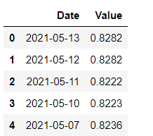
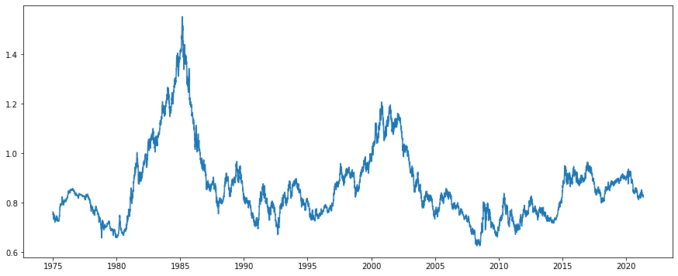
Library Used: statsmodels
Data View :
Visualize the raw data:
Visualize the time series to see how the Euro is trending against the US dollar over time.

Slide 10
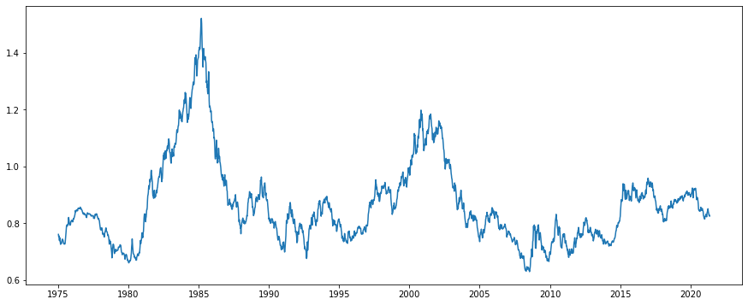
Resample the data:
Using daily data for your time series contains too much variation, so first resample the time series data by week. Then use this resampled time series to predict the Euro exchange rates against the US Dollar.

Slide 11
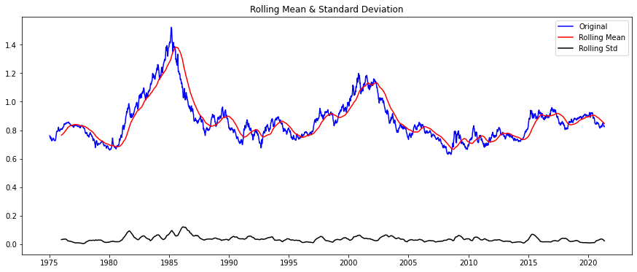
Check for stationarity:
Calculate the moving variances, plot the results and apply the Dickey-Fuller test on the time series:

Slide 12
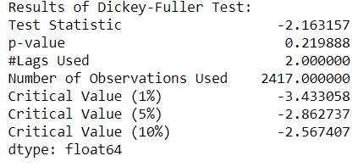
Because the test statistic is more than the 5% critical value and the p-value is larger than 0.05, the moving average is not constant over time and the null hypothesis of the Dickey-Fuller test cannot be rejected. This shows that the weekly time series is not stationary.
Before applying ARIMA models for forecasting, it need to transform this time series into a stationary time series.

Slide 13
Methodology
Stationarize the time series
Apply a nonlinear log transformation
Remove trend and seasonality with decomposition
Remove trend and seasonality with differencing
Find optimal parameters and build an ARIMA model
Plot the autocorrelation function (ACF) and partial autocorrelation function (PACF)
Measure the variance between the data and the values predicted by the model
Scale predictions
Perform and visualize time series forecasting

Slide 14
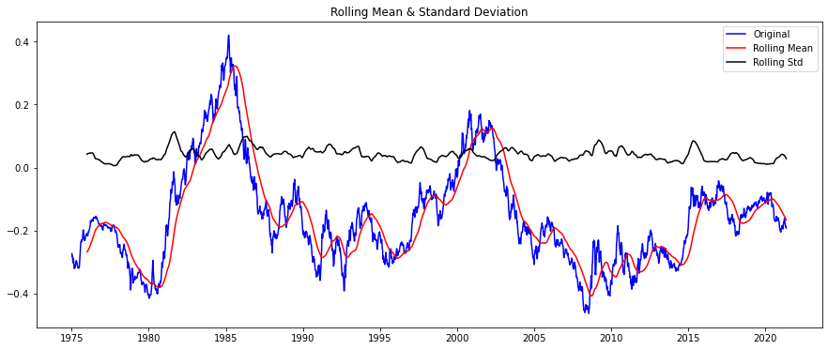
Stationarize the time series
Apply a nonlinear log transformation :
Begin by applying a simple, nonlinear log transformation and checking for stationarity.

Slide 15
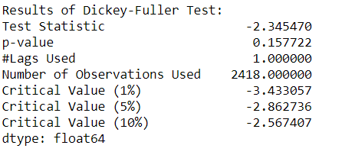
The Dickey-Fuller test results confirm that the series is still non-stationary. Again the test statistic is larger than the 5% critical value and the p-value larger than 0.05.

Slide 16
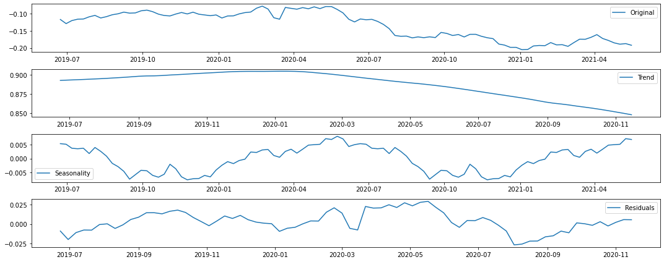
Remove trend and seasonality with decomposition:
Next, decompose the time series to remove trend and seasonality from the data. Decomposition results show an decreasing trend and seasonal effect of approximately a 12 month cycle for the more recent weeks in the data set.

Slide 17
Now stationarized the time series, and model residuals (fit lines between values in the plot). However, as the patterns for the trend and seasonality information extracted from the series that are plotted after decomposition are still not consistent and cannot be scaled back to the original values, cannot use this approach to create reliable forecasts.

Slide 18
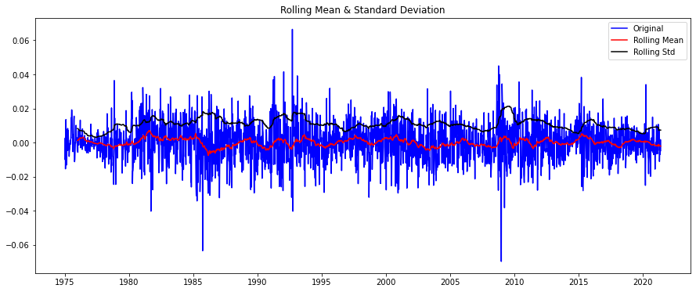
Remove trend and seasonality with differencing
Differencing is one of the most common methods of dealing with both trend and seasonality. In first order differencing, compute the differences between consecutive observations in the time series. This usually improves the stationarity of the time series., this is confirmed by running the Dickey-Fuller test.

Slide 19
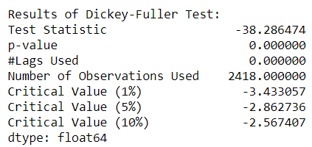
The results show that the test statistic is significantly less than the 1% critical value.
This shows that our time series is now stationary with 99% confidence. Now begin to apply statistical models like ARIMA to forecast future Euro exchange rates using this stationarized time series.

Slide 20
Find optimal parameters and build an ARIMA model
P –Order of autoregression how many lag variables to choose
D –Order of Integration Number of differencing needed
Q –Order of Moving Average What is the window size for Moving Average
To apply an ARIMA model to our time series, find optimal values for the following three model parameters (p,d,q):
The number of autoregressive (AR) terms (p): AR terms are just lags of the dependent variable, the euro rate, in this case. So, if p=2, it means that predictors of x(t) will be x(t-1) and x(t-2).
The number of moving average (MA) terms (q): MA terms are lagged forecast errors in the prediction equation. For instance, if q=2, the predictors for x(t) will be e(t-1) and e(t-2) where e(i) is the difference between the moving average at i-th instant and the actual value.
The number of differences (d): These are the number of non-seasonal differences. In my case, d=1, modeling using the first order differenced time series.
There are two ways to determine the number of AR and MA terms. The first is to use the arma_order_select_ic function in Python. The second uses plots of the autocorrelation function (ACF) and partial autocorrelation function (PACF).

Slide 21
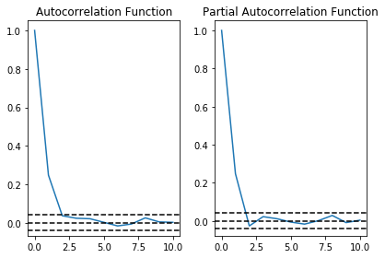
Plot the autocorrelation function (ACF) and partial autocorrelation function(PACF)
The ACF and PACF, and determine the p, d and q model parameters which are required later as input for the ARIMA model
In this plot, the 'p' and 'q' values can be determined as follows:
p: The lag value where the PACF cuts off (drops to 0) for the first time. If we look closely, p=2.
q: The lag value where the ACF chart crosses the upper confidence interval for the first time. If we look closely, q=2.
This means that the optimal values for the ARIMA(p,d,q) model are (2,1,2).

Slide 22
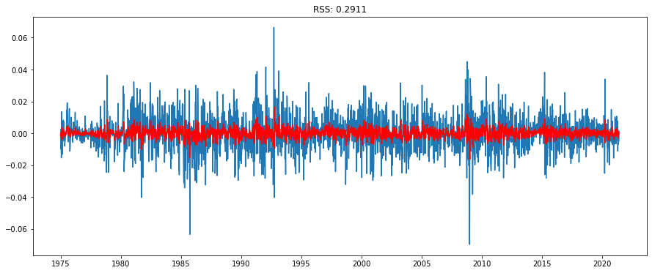
It is possible for an AR and an MA term to cancel each other's effects in a mixed AR-MA model. The residual errors seem fine with near zero mean and uniform variance.

Slide 23
Measure the variance between the data and the values predicted by the model
The results of model fit the underlying data by using the residual sum of squares (RSS) metric. A small RSS indicates that the model fits tightly to the data.
Yet another approach to validate the ARIMA model appropriateness is by performing residual analysis.
Print the results of the ARIMA model and plot the residuals. A density plot of the residual error values indicates a normal distribution centered around zero mean. Also, the residuals do not violate the assumptions of constant location and scale with most values in the range (-1,1).

Slide 24
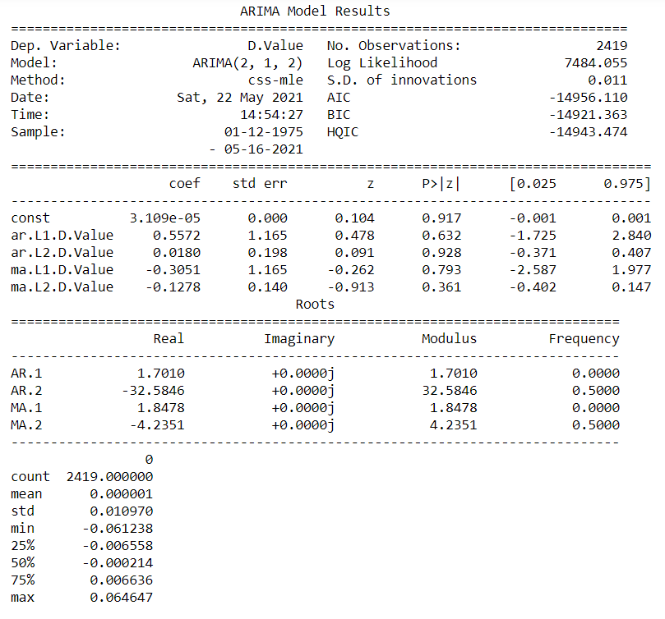
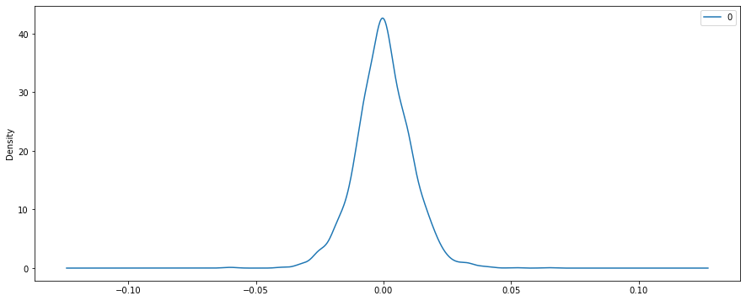
The model validation checks confirmed good results.

Slide 25
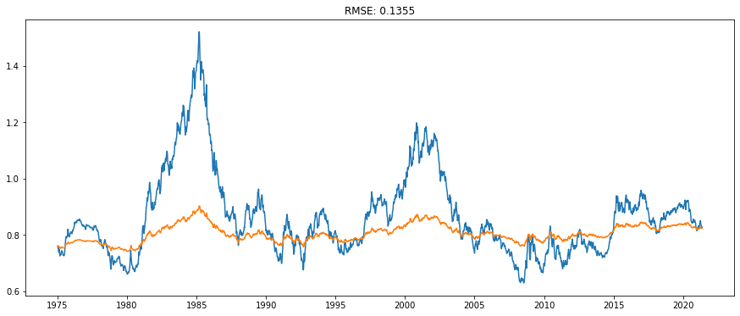
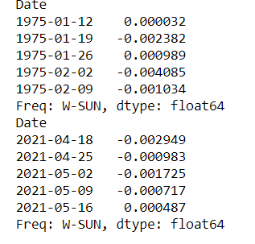
Scale Predictions
The lower the root mean square error (RMSE) and the closer it is to 0, the better are the model predictions in being closer to actual values.
The RMSE is close enough to 0: the model predictions are accurate.

Slide 26
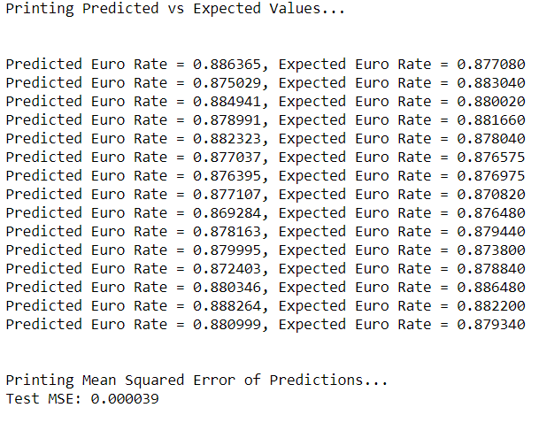
Perform and visualize time series forecasting
As I trained the model on the entire time series data. Then need to split the data set into a training and testing data sets. The training data set to train the ARIMA model and perform out-of-sample forecasting. Then compare the results of out-of-sample predictions for Euro rates with the actual values from the test data set.
The forecast function, forecast and perform a rolling one-step forecast with ARIMA. A rolling forecast is required given the dependence on observations during differencing and the AR model. And will re-create the ARIMA model after each new prediction is received. It will manually keep track of all observations in a list called history, which is seeded with the training data and to which new predictions are appended in each iteration.

Slide 27
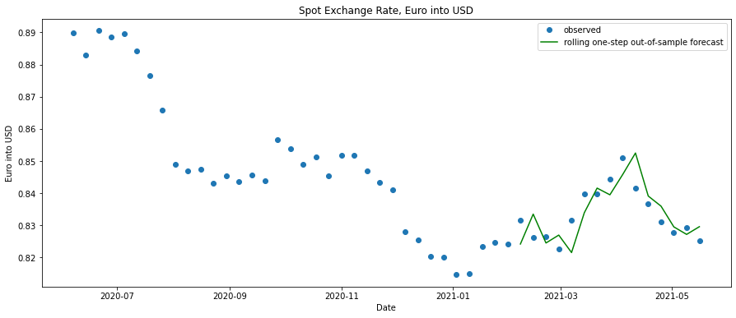
Validated the model by comparing its out-of-sample predictions for Euro rates with actual values from the test data set and calculating the mean squared error. Now ploting the rolling forecast predictions against the observed values. The predictions are observed in the correct scale and are picking up the trend in the original time series.

Slide 28
Conclusion
Forecasting techniques rely on the weaknesses of the efficient market hypothesis, acknowledging the existence of market inefficiencies, with markets displaying even weak signs of predictability.
Forecasting techniques are dependent on the quality and nature of the data used. If the solution to a problem is not within the data, then no technique can extract it. In addition, sufficient information should be contained within the in-sample period to be representative of all cases within the out-of-sample period.
It has been observed that ARIMA model can provide an evolution equation with a simple interpretation. Forecasting successfully appears that when model can predict the sign of future exchange rate returns regardless to the magnitude of the movement . The result are promising and might hopefully give place for future research.

Slide 29
Future Scope
Many researchers agree that individual forecasting methods are mis-specified in some manner, suggesting that combining multiple forecasts leads to increased forecast accuracy .Thus in future it may be suggested that following work may be done in order to get accurate forecasting results .
NNR models can add value to the forecasting process, and that, for the EUR/USD exchange rate and the period considered, NNR models outperform the more.

Slide 30
References
Brzeszcynski, J., and Melvin M., “Exploring trading volume in the Euro”., International Journal of Finance and Economics , Vol11, pp 25-34 , 2006.
C. U. Yıldıran, A. Fettaho˘glu, “Forecasting USD/TRY rate by ARIMA method ”, Cogent Economics and Finance, Vol.5, pp 1–11 , 2017 .
Tyree, E. W., & Long, J. A..“ Forecasting currency exchange rates: Neural networks and the random walk model. ” City University Working Paper, Proceedings of the Third International Conference on Artificial Intelligence Applications, New York. 1995.
Bellgard, C., & Goldschmidt, P. “ Forecasting across frequencies: Linearity and non-linearity ”. University of Western Australia Research Paper, Proceedings of the International Conference on Advanced Technology, Australia , 1999
Weisang, G., & Yukika, A. “Vagaries of the Euro: An Introduction to ARIMA modeling”. 2008

Slide 31
Thank You

